Slide 1
Listen Bro!
Didn’t Hear? Bro is here.

Slide 2
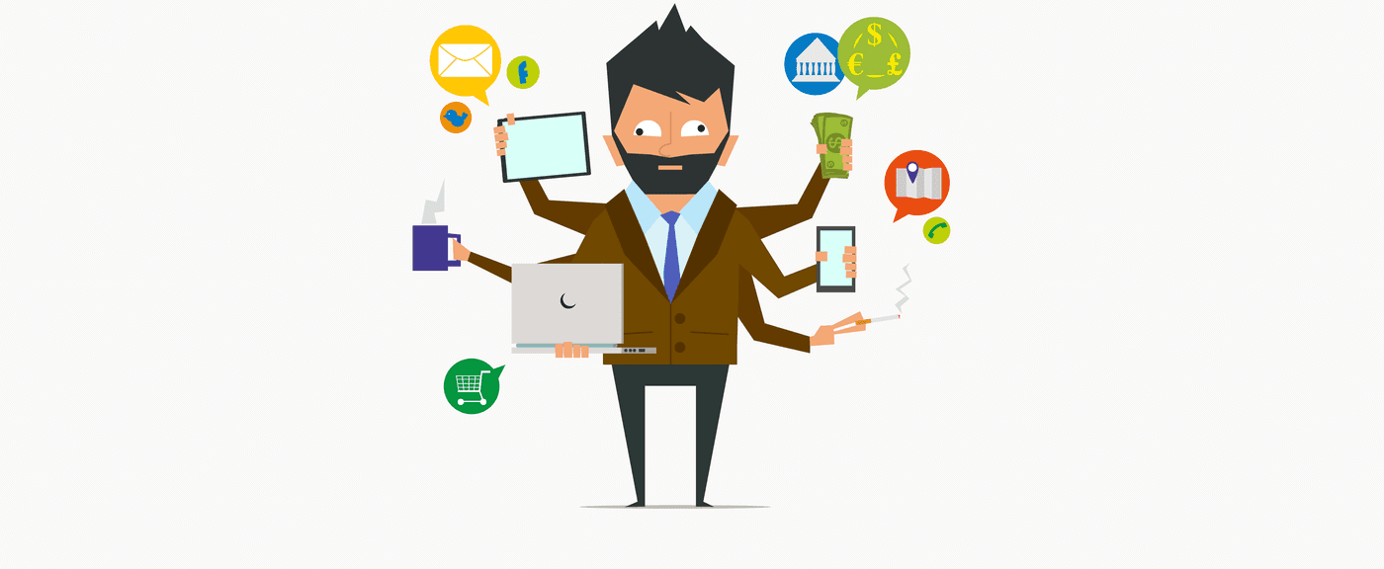
What Brought Us Here?

Slide 3

Meet Bro
Wearable pervasive device.
Catches audio input when triggered.
Makes notes of relevant data captured.
Notifies you as and when required.

Slide 4
Bro is EVERYWHERE!
Seminars and Meetings
Schools and Colleges
As a personal Assistant
Health care – for patients
Home makers
Sky is the limit…

Slide 5
Under the Hood
Microphone Imbedded on wearable devices.
AI based Speech to Text Conversion.
Sentiment and Intent analysis.
Integrated to the Cloud.
APIs for App integrations.

Slide 6

Bro can Earn a Lot
In App Purchases according to Services.
Developer Integration Fee.
Cost according to Storage Space.
Partnership with Wearable's Vendors.

Slide 7
Bro Needs Your Support
2 Year Plan
1st Semi - Product Design & Market Analysis
2nd Semi - Marketing and Implementation in a city.
3rd Semi - Launches in multiple markets.
4th Semi - Global distribution.

Slide 8

Questions for Bro?

Slide 9


